Slide 1
Object Oriented Programing
tiennm@sphinx-software.com

Slide 2
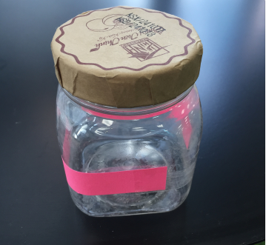
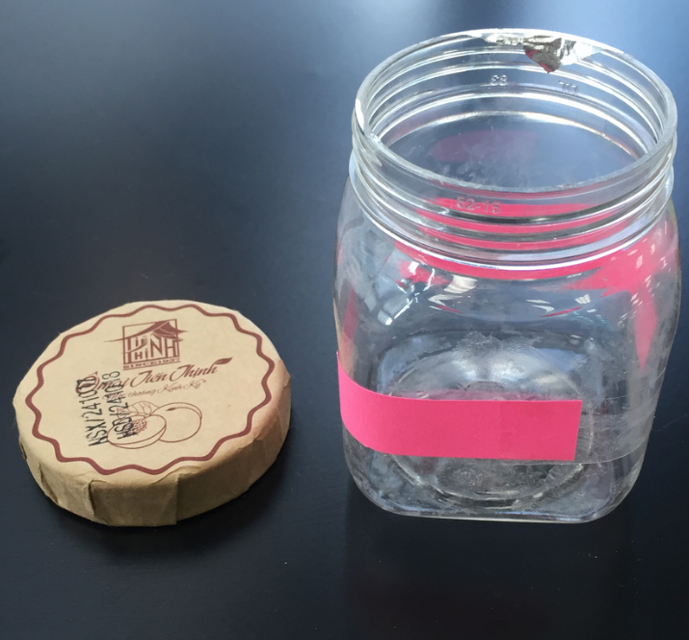

Definitions.
What is OOP?
Object-oriented programming
What is an Object?
The answer is
It depends on something called:

Slide 3
Definitions.
Class
Template, blueprints …
Relation between Class, Instance and Object
An OBJECT is an INSTANCE of a CLASS

Slide 4
Fundamentals
Abstraction
Encapsulation
Inheritance
Polymorphism

Slide 5

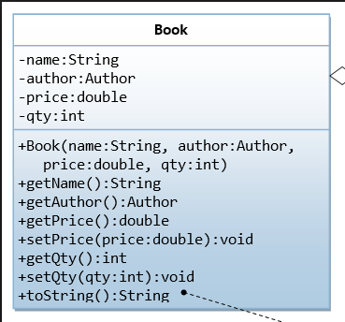
Abstraction
Abstraction

Slide 6

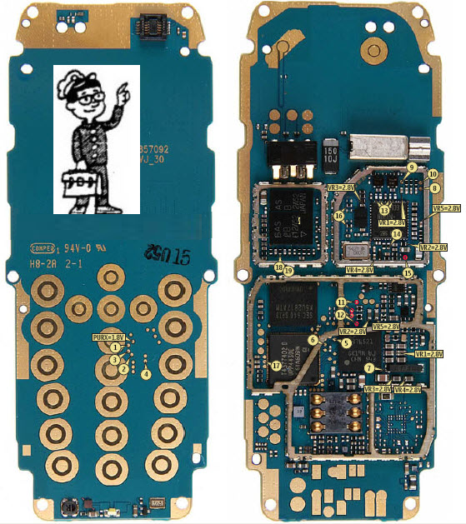
Encapsulation
Is it information hiding?
Does it use for
Security purpose?

Slide 7


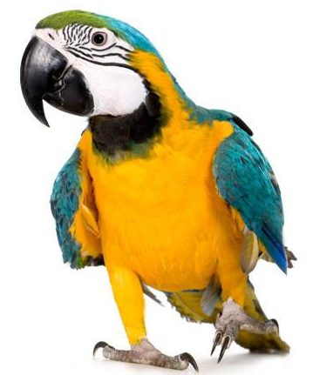
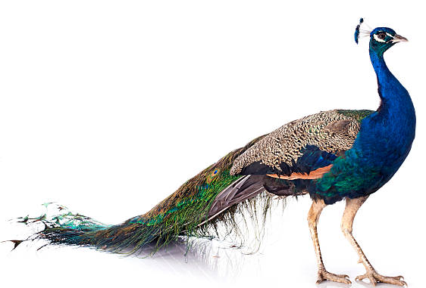
Inheritance
Animals

Slide 8

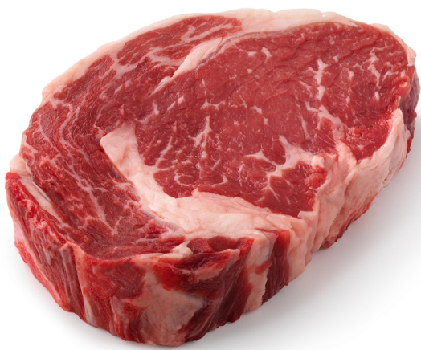
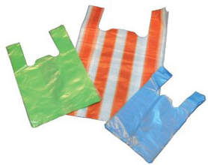

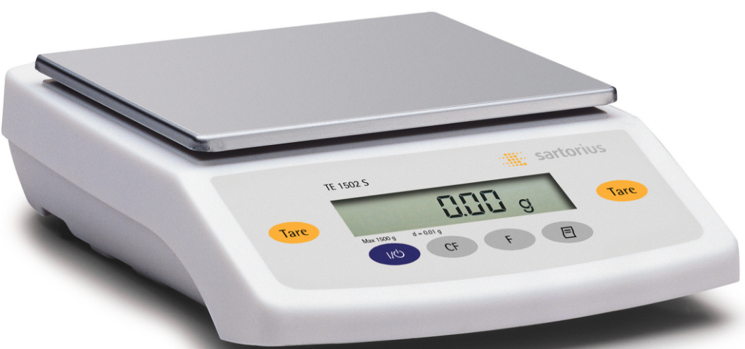
Polymorphism

